Slide 1
The Virtual Brain
http://www.thevirtualbrain.org
The Virtual Brain (TVB) is a neuroinformatics platform for full brain network simulations using biologically realistic connectivity. Itenables the model-based inference of neurophysiological mechanisms across different brain scales that underlie the generation of macroscopic neuroimaging signals including functional MRI (fMRI), EEG and MEG.
Neuroinformatics tutorial
1.4 Simulation environments

Slide 2
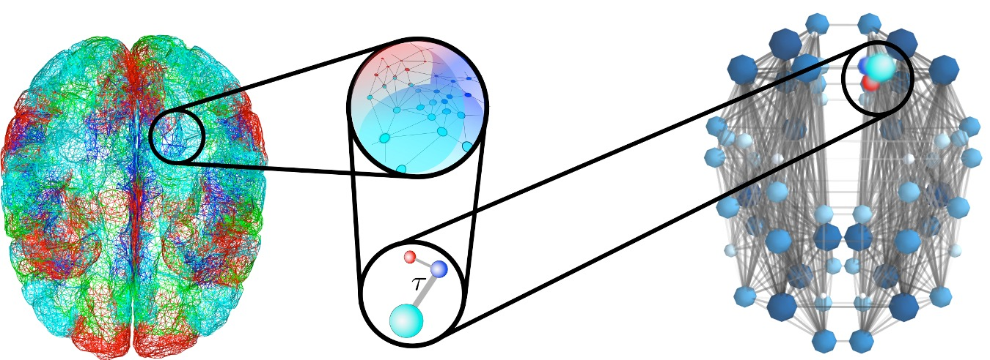



Large-scale brain networks
Network node:
Mean field modeling
Connectome:
connectivity & time delays

Slide 3
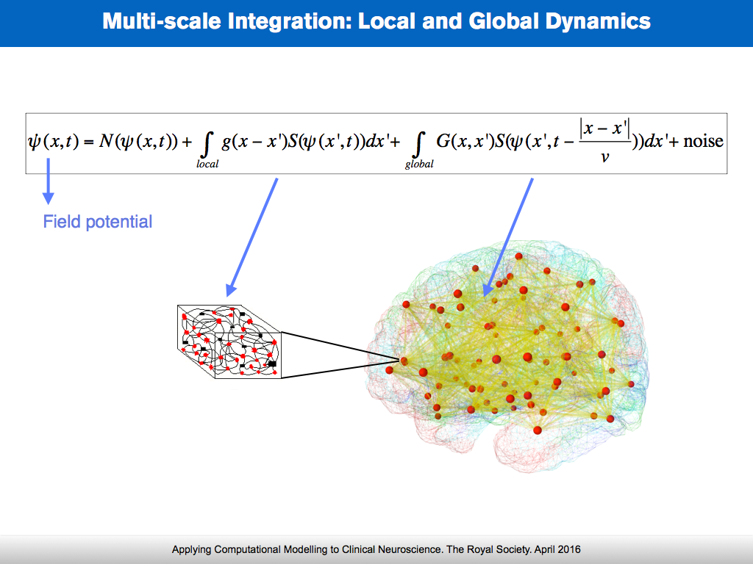


Microscopic unit of modeling: neuronal population
Local dynamics
Global dynamics
1mm
Neuronal population
Jirsa et al IEEE 2002
Ghosh et al. PLoS CB 2008
Deco, Jirsa, McIntosh Nat Rev Neurosci 2011
Deco, Jirsa Journ Neurosci 2012
Deco, Jirsa, McIntosh TINS 2013
Ritter et al Brain Connectivity 2013
Sanz Leon et al Front NeuroInformatics 2013; Neuroimage 2015
Technology Transfer in Physics and Chemistry

Slide 4
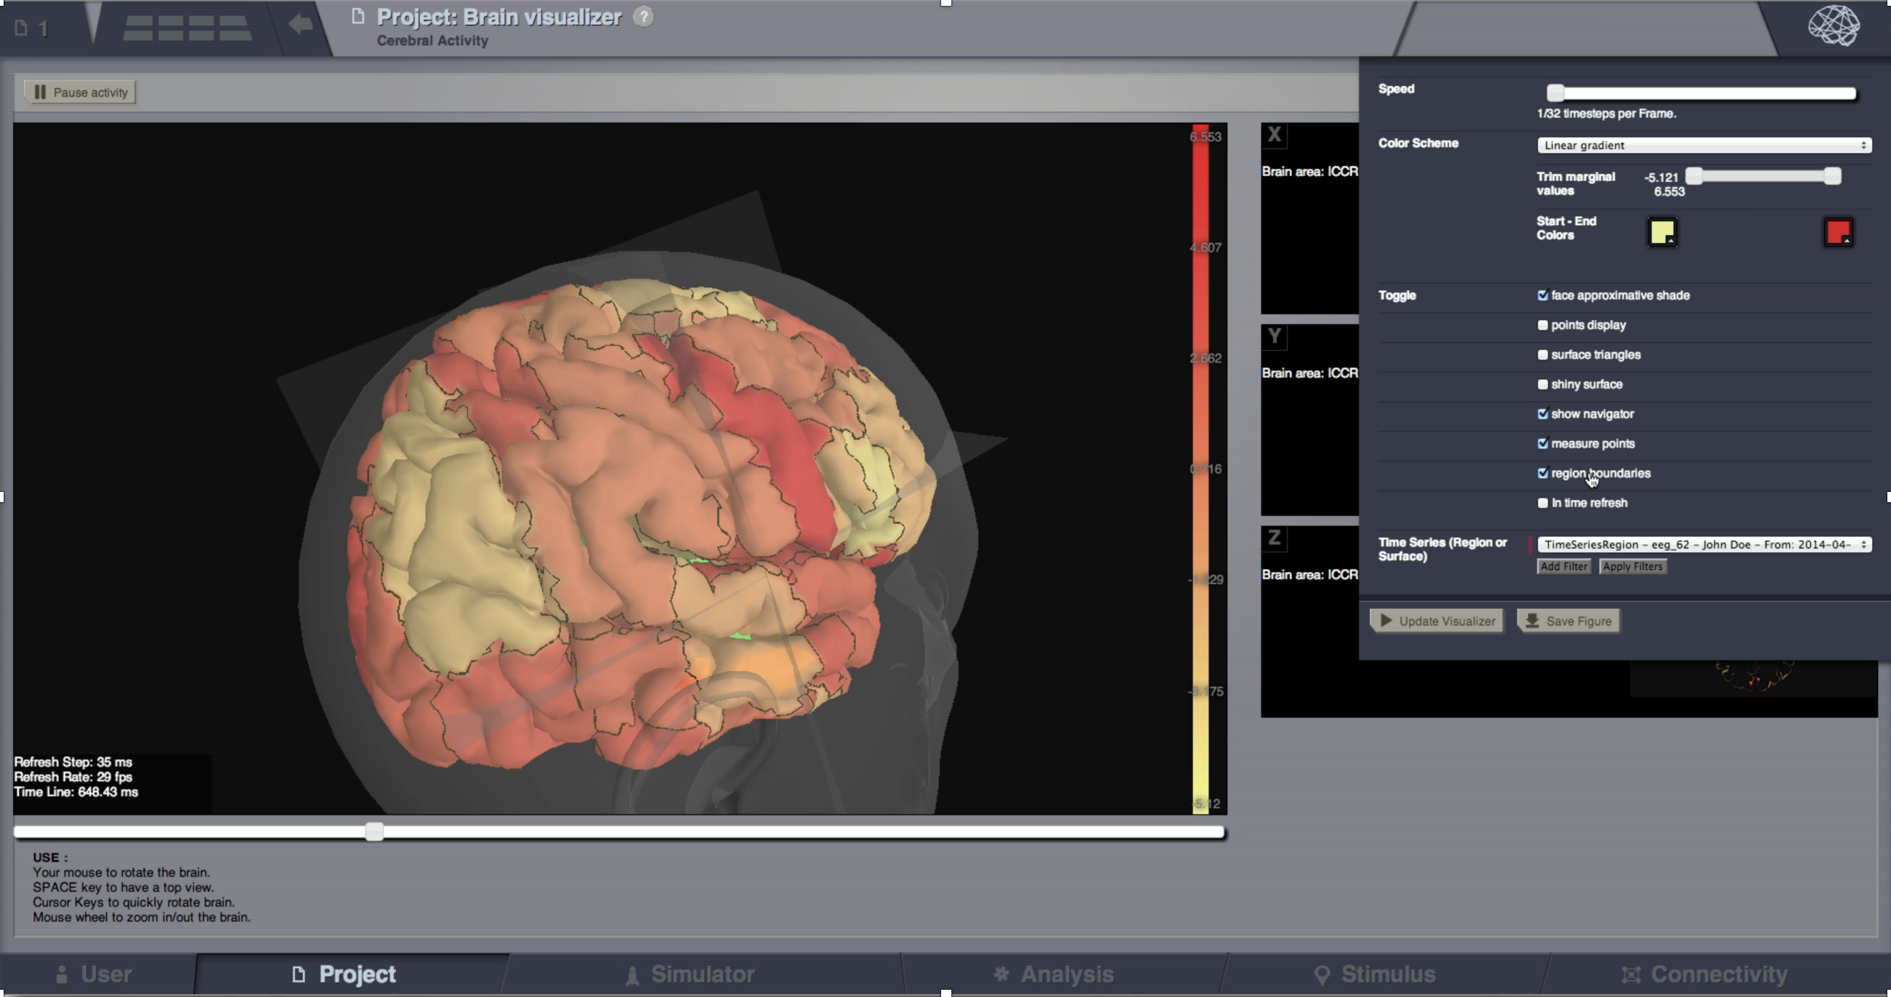
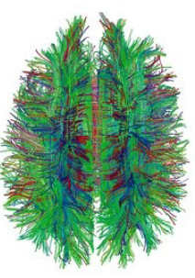
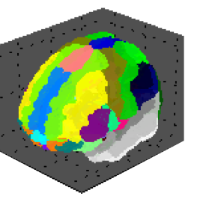
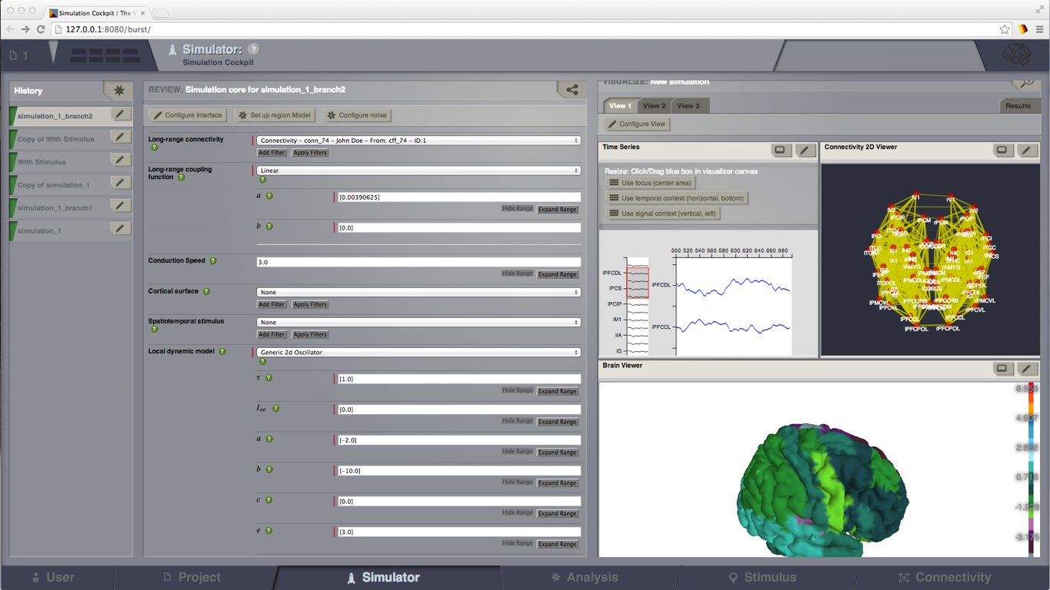
The Virtual Brain (TVB) platform release in 2012
DTI/ Tractography
Parcellation
Template
Jirsa et al IEEE 2002
Ghosh et al. PLoS CB 2008
Deco, Jirsa, McIntosh Nat Rev Neurosci 2011
Deco, Jirsa Journ Neurosci 2012
Deco, Jirsa, McIntosh TINS 2013
Ritter et al Brain Connectivity 2013
Sanz Leon et al Front NeuroInformatics 2013; Neuroimage 2015

Slide 5
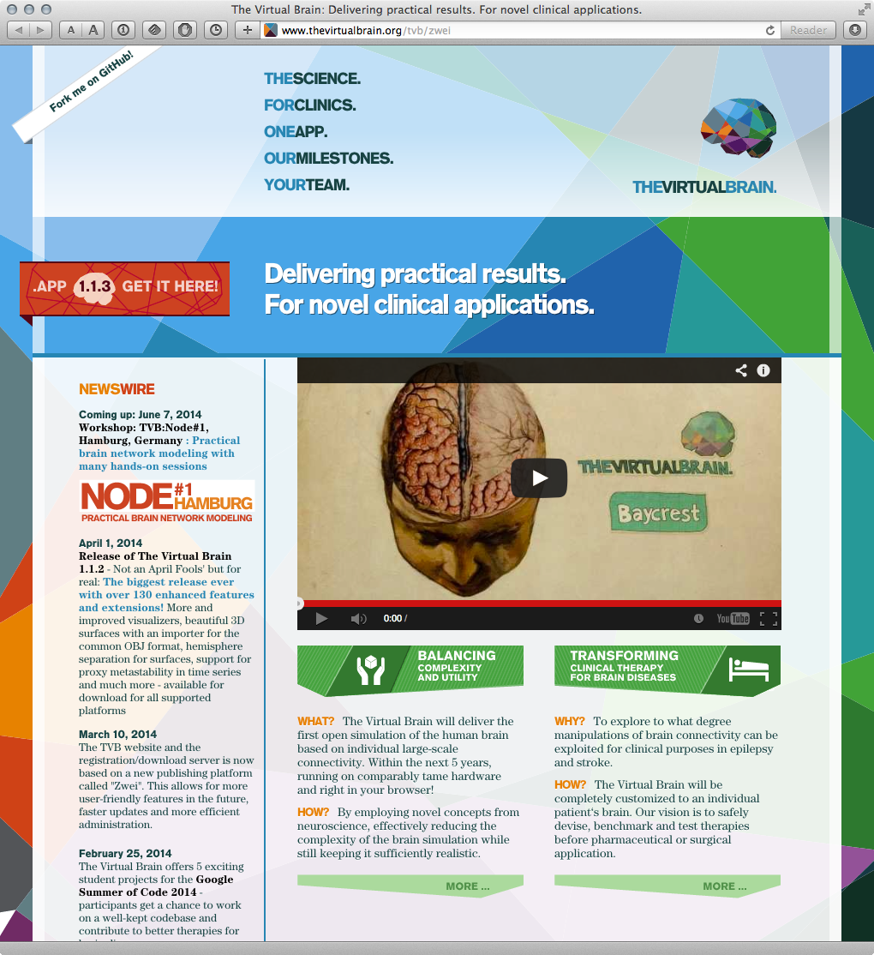
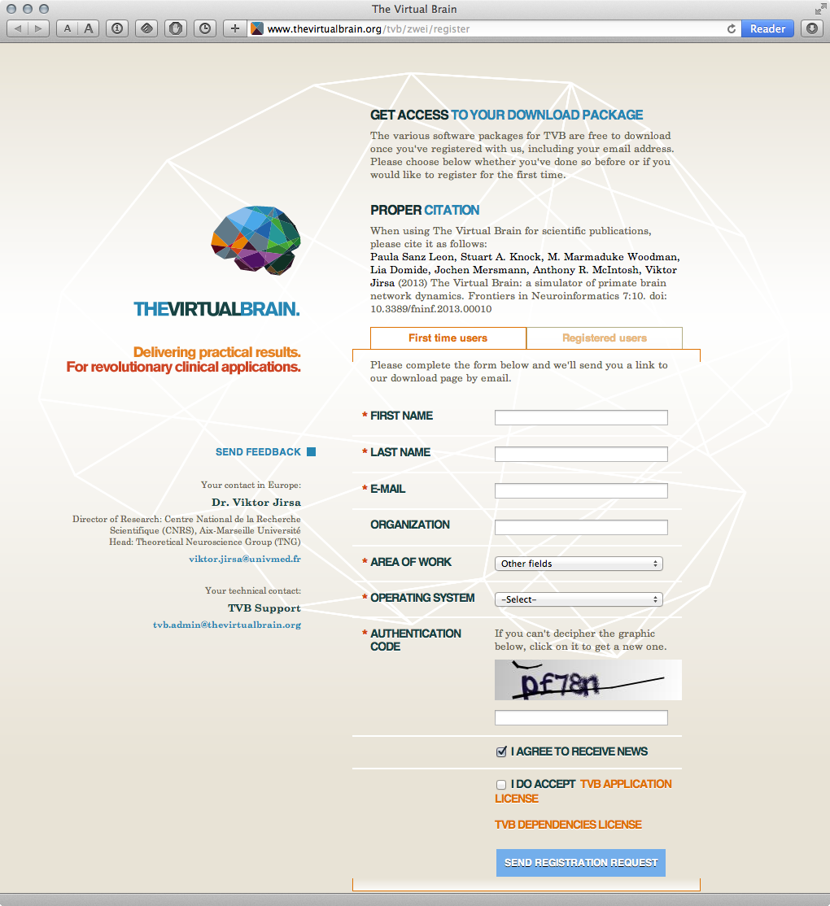
www.thevirtualbrain.org
Download: Windows, Mac, Linux
6369 registered users in June 2017
http://www.thevirtualbrain.org

